Slide 1

unpackAI -
Review Session

Slide 2
WeChat Questions (from Sasha)
These are questions from Sasha - I did not find question 1, actually in a data science way it should start with question “0” - LOL
Q2: in hospital patients were measured their body temperature after results they’ were classified 36.6. - “Normal”, 37.3 - “Asymptomatic”, 39 - “Infected” all got their classification. Normal, Asymptotic, Infected is it Categorical data or Continuous? - Categorical
Q3: can you elaborate during the session more about parameters business owner need to look into except AUC when talking to the modeling team?
Q4: working with data sets having original data (citizenship, occupation etc. does it make sense to replace categories into the numerical data (like we have 150 + countries thus every country is equal to a number)
Q5: GPS location coordinates what kind of data it is?

Slide 3
In this week we studied a Classification problem
What is a classification problem in Machine Learning?
Goal: Classification algorithms are used to predict/Classify into classes such as Male or Female, True or False, Spam or Not Spam, etc.
Method: Classification is a process of finding a function which helps in dividing the dataset into classes based on different parameters.
Notes:
Only allow graduates of DL 101 to join the Slack channel to guarantee an active channel? (seems like a stupid idea but I wanted to put an online communication tool here.)

Slide 4
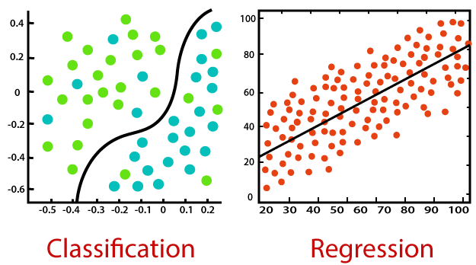
Classification
Method: Classification is a process of finding a function which helps in dividing the dataset into classes based on different parameters.
A computer program is trained on the training dataset and based on that training, it categorizes the data into different classes.
Types of Classification: Single Class & Multi Class
Notes:
Only allow graduates of DL 101 to join the Slack channel to guarantee an active channel? (seems like a stupid idea but I wanted to put an online communication tool here.)

Slide 5
Classification
What ML Classification Problems do you know?
Customer Churn Rate
Employee Turnover
Notes:
Customer Churn Excel Example: https://docs.google.com/spreadsheets/d/1f3Ls7TC_9yNfwPPu5CVAWaPgtVWED4qDJZRO84JZC_k/template/preview
Employee Turnover Excel Example: https://docs.google.com/spreadsheets/d/12WVOSrBaprNdAD20AdY0BGtP39UfHWPJYwpW0FF6o30/template/preview

Slide 6
Regression
What is a regression problem in Machine Learning?
Goal: Regression algorithms are used to predict the continuous values such as price, salary, age,
Method: Regression is a process of finding the correlations between dependent and independent variables.
Notes:
Only allow graduates of DL 101 to join the Slack channel to guarantee an active channel? (seems like a stupid idea but I wanted to put an online communication tool here.)

Slide 7
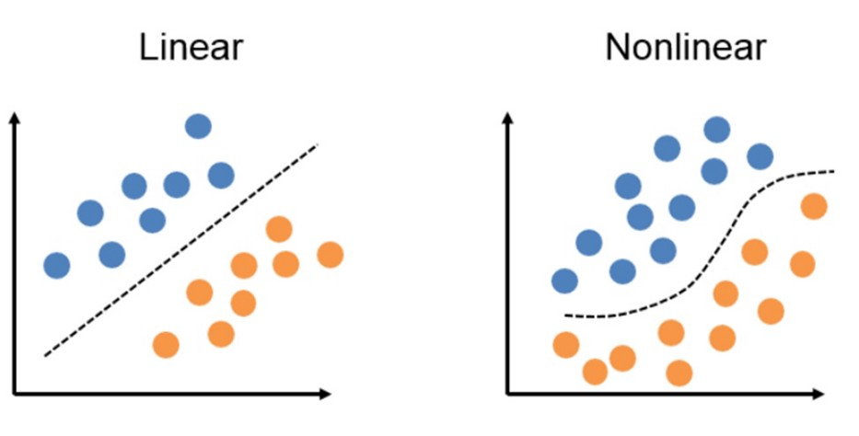
Regression
Method: Regression is a process of finding the correlations between dependent and independent variables.
Types: Linear and Non-linear Regression
Notes:
Only allow graduates of DL 101 to join the Slack channel to guarantee an active channel? (seems like a stupid idea but I wanted to put an online communication tool here.)

Slide 8
Regression
What ML Regression Problems do you know?
Marketing Mix Revenue Prediction
Site Visitor Analytics
SEO analytics
Notes:
Marketing Mix Revenue Prediction: https://docs.google.com/spreadsheets/d/1L40o9jMDc1AHRckfyPq_xU3qAerrUFIk7Nuuq59ZyOk/template/preview
Site Visitor Analytics: https://docs.google.com/spreadsheets/d/19p5c89E4IwS73-6RbaB96AdmNg_7DatP1ASKiMeA45Q/template/preview
SEO: https://docs.google.com/spreadsheets/d/1qF2dxvwYvbiRqtkl9u0yR6wjzWJtWeWubCSU0hw6FKA/template/preview

Slide 9
How do they differ?
Classification
Regression
Classification algorithms are used to predict/Classify discrete values.
Regression algorithms are used to predict continuous values
Objective:
Target variable:
Categorical/discrete Variable
Continuous Variable
Loss Function:
Cross Entropy (= measures probability prediction error between prediction and actual class)
Mean Squared Error (= average of the squares of the errors (difference between predictions and actual values)
Notes:
Marketing Mix Revenue Prediction: https://docs.google.com/spreadsheets/d/1L40o9jMDc1AHRckfyPq_xU3qAerrUFIk7Nuuq59ZyOk/template/preview
Site Visitor Analytics: https://docs.google.com/spreadsheets/d/19p5c89E4IwS73-6RbaB96AdmNg_7DatP1ASKiMeA45Q/template/preview
SEO: https://docs.google.com/spreadsheets/d/1qF2dxvwYvbiRqtkl9u0yR6wjzWJtWeWubCSU0hw6FKA/template/preview

Slide 10
Thanks for joining!

